Slide 1
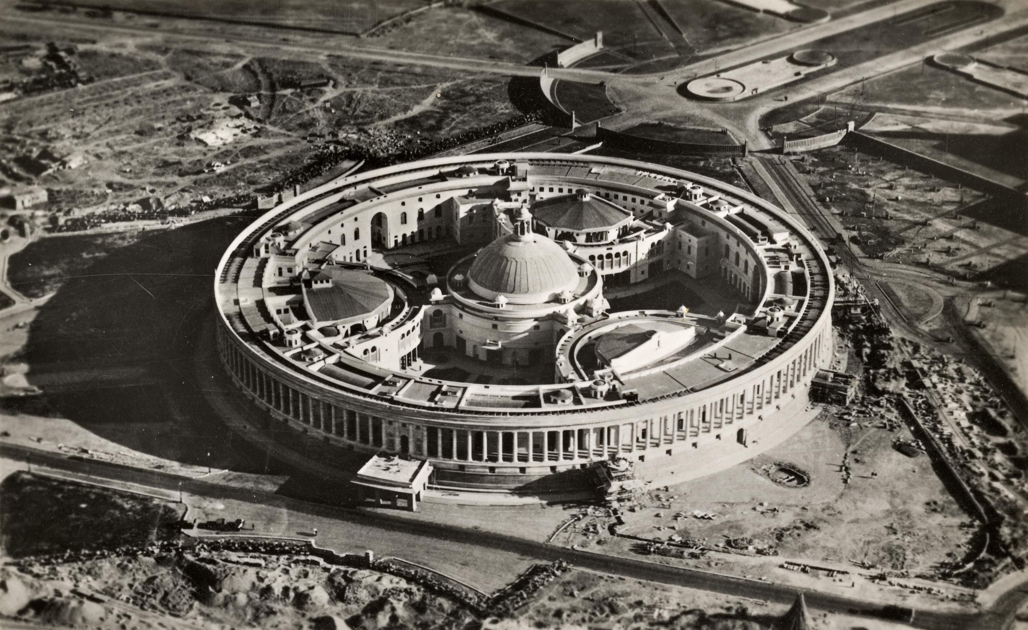
Freedom of religion is a fundamental right guaranteed under Articles 25 to 28 of the Indian Constitution. It ensures that every individual has the liberty to follow, practice, and express their religious beliefs according to their conscience. Citizens are free to profess, practice, and propagate any religion of their choice.
At the same time, this freedom is not absolute. The State can impose reasonable restrictions in the interests of public order, morality, health, and social welfare. The Constitution also ensures that the State remains neutral in religious matters and does not promote or fund any particular religion. Through these provisions, freedom of religion balances individual belief with social harmony and upholds the secular character of India.

Slide 2

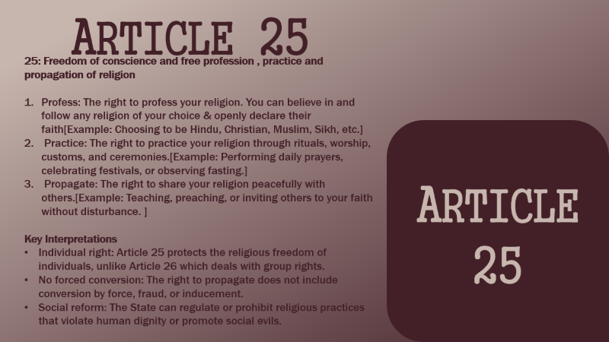
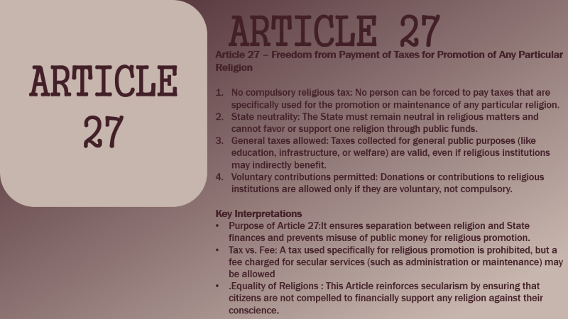

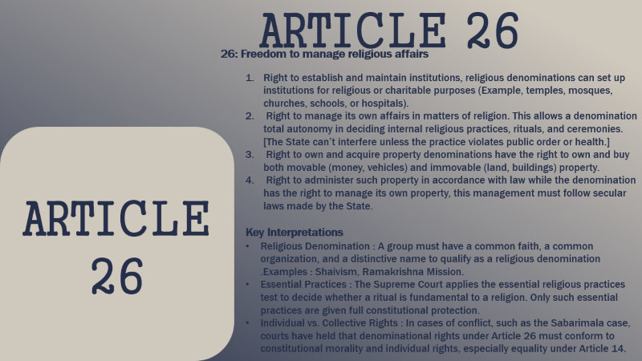


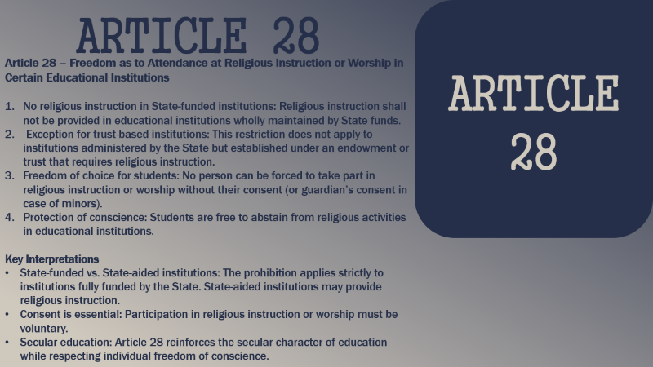

Slide 3
ARTICLE 25
25: Freedom of conscience and free profession , practice and propagation of religion
Profess: The right to profess your religion. You can believe in and follow any religion of your choice & openly declare their faith[Example: Choosing to be Hindu, Christian, Muslim, Sikh, etc.]
Practice: The right to practice your religion through rituals, worship, customs, and ceremonies.[Example: Performing daily prayers, celebrating festivals, or observing fasting.]
Propagate: The right to share your religion peacefully with others.[Example: Teaching, preaching, or inviting others to your faith without disturbance. ]
Key Interpretations
Individual right: Article 25 protects the religious freedom of individuals, unlike Article 26 which deals with group rights.
No forced conversion: The right to propagate does not include conversion by force, fraud, or inducement.
Social reform: The State can regulate or prohibit religious practices that violate human dignity or promote social evils.
ARTICLE 25

Slide 4
ARTICLE 26
26: Freedom to manage religious affairs
Right to establish and maintain institutions, religious denominations can set up institutions for religious or charitable purposes (Example, temples, mosques, churches, schools, or hospitals).
Right to manage its own affairs in matters of religion. This allows a denomination total autonomy in deciding internal religious practices, rituals, and ceremonies. [The State can’t interfere unless the practice violates public order or health.]
Right to own and acquire property denominations have the right to own and buy both movable (money, vehicles) and immovable (land, buildings) property.
Right to administer such property in accordance with law while the denomination has the right to manage its own property, this management must follow secular laws made by the State.
Key Interpretations
Religious Denomination : A group must have a common faith, a common organization, and a distinctive name to qualify as a religious denomination .Examples : Shaivism, Ramakrishna Mission.
Essential Practices : The Supreme Court applies the essential religious practices test to decide whether a ritual is fundamental to a religion. Only such essential practices are given full constitutional protection.
Individual vs. Collective Rights : In cases of conflict, such as the Sabarimala case, courts have held that denominational rights under Article 26 must conform to constitutional morality and individual rights, especially equality under Article 14.
ARTICLE
26

Slide 5
ARTICLE
27
ARTICLE 27
Article 27 – Freedom from Payment of Taxes for Promotion of Any Particular Religion
No compulsory religious tax: No person can be forced to pay taxes that are specifically used for the promotion or maintenance of any particular religion.
State neutrality: The State must remain neutral in religious matters and cannot favor or support one religion through public funds.
General taxes allowed: Taxes collected for general public purposes (like education, infrastructure, or welfare) are valid, even if religious institutions may indirectly benefit.
Voluntary contributions permitted: Donations or contributions to religious institutions are allowed only if they are voluntary, not compulsory.
Key Interpretations
Purpose of Article 27:It ensures separation between religion and State finances and prevents misuse of public money for religious promotion.
Tax vs. Fee: A tax used specifically for religious promotion is prohibited, but a fee charged for secular services (such as administration or maintenance) may be allowed
.Equality of Religions : This Article reinforces secularism by ensuring that citizens are not compelled to financially support any religion against their conscience.

Slide 6
ARTICLE 28
ARTICLE
28
Article 28 – Freedom as to Attendance at Religious Instruction or Worship in Certain Educational Institutions
No religious instruction in State-funded institutions: Religious instruction shall not be provided in educational institutions wholly maintained by State funds.
Exception for trust-based institutions: This restriction does not apply to institutions administered by the State but established under an endowment or trust that requires religious instruction.
Freedom of choice for students: No person can be forced to take part in religious instruction or worship without their consent (or guardian’s consent in case of minors).
Protection of conscience: Students are free to abstain from religious activities in educational institutions.
Key Interpretations
State-funded vs. State-aided institutions: The prohibition applies strictly to institutions fully funded by the State. State-aided institutions may provide religious instruction.
Consent is essential: Participation in religious instruction or worship must be voluntary.
Secular education: Article 28 reinforces the secular character of education while respecting individual freedom of conscience.

Slide 7
The Right to Freedom of Religion under Articles 25 to 28 is a vital pillar of the Indian Constitution that upholds individual liberty, religious tolerance, and secularism. It guarantees freedom of conscience and allows individuals and religious groups to profess, practice, and manage religious affairs. At the same time, these rights are not absolute and are subject to reasonable restrictions in the interests of public order, morality, health, social welfare, and constitutional morality.
These Articles ensure State neutrality in religious matters by prohibiting the use of public funds for promoting any religion and by safeguarding freedom of choice in educational institutions. By balancing religious freedom with equality, human dignity, and social harmony, the Constitution ensures that religion remains a matter of personal faith and collective identity without becoming a source of discrimination or conflict.

